Slide 1
Correctional Facility Author Institutional Affiliation Instructor Course code Date of submission

Slide 2
Introduction
It is indicated that close to 90,000 juveniles are held in various justice facilities across the United States (Kyckelhahn, 2015).
A significant percentage of these justice facilities are state-funded with the government spending close to 250 dollars per juvenile each day.
Various stakeholders in the justice system have been keen to ensure that the juvenile facilities operate within reasonable budgets with the main aim of reducing juvenile delinquency.
For this reason, this current project presents a description for the establishment of a juvenile correctional and rehabilitative facility for juveniles aged between 13 and 17 years.

Slide 3
The general description of the facility is as outlined below:
State-level juvenile correctional and rehabilitative facility
Minimum security facility

Slide 4
Facility information
The facility shall be located in Lynchburg City in Virginia.
As observed, this facility shall specialize in juvenile correctional and rehabilitation programs admitting juvenile offenders between the ages of 13 and 17.
The facility shall be located in the outskirts of the city because of its space requirements.
The space required for the construction of this correction facility is approximated to be about 200 acres of flat land.
Total rooms would be 200 rooms, well portioned within a two-storey building.
All the rooms shall be fitted with 24-hour surveillance cameras with unharmed access into and out of the rooms.

Slide 5
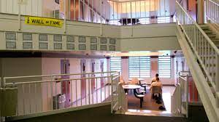
A Snapshot of the interior of the correctional Facility

Slide 6
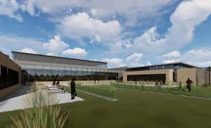
A Snapshot of the external of the correctional Facility

Slide 7
Staffing
The main goal of staffing is to effectively fill up the various roles in an organization with suitable candidates.
Just like any other typical correctional facility, the staffing at this facility would comprise the correctional and rehabilitation program officers.
These officers include wardens, counsellors, sergeants among other correctional officers.
Additionally, the facility shall also have support staff to engage in activities such as maintenance, kitchen and even healthcare.
In the division of education, the facility shall have a principal, instructors, administrative and other staff

Slide 8
Programs
Understandably, this is a correctional facility, some of the programs for inclusion include:
Educational programs: the federal regulations require all inmates to get their General Education Development (GED), this facility shall offer educational programs to the offenders without a high school diploma (Virginia - Department of Corrections, 2016).
Counselling programs: Because the main intent of this establishment is to correct and rehabilitate, the facility shall also provide intensive counselling programs for the inmates for four days every week particularly in the afternoon
Religious programs: The facility shall have these programs over weekends to ensure that the young inmates remain close to God.
It is believed that religious programs would help rekindle their hope in life.

Slide 9
Budget
The approximated budget for the facility would be a total of 10, 000, 000 dollars.
General operations would require 8, 000 000 dollars with an additional 2 million dollars for the educational programs.

Slide 10
References
Kyckelhahn, T. (2015, February 26). http://www.bjs.gov/content/pub/sheets/jeeus12p.zip [Excel]. Bureau of Justice Statistics.
Commonwealth of Virginia - Department of Corrections - Facilities. (2016). Vadoc.virginia.gov. https://vadoc.virginia.gov/facilities/
About the Juvenile Treatment Centers and Correctional Facilities. (n.d.). http://humanservices.arkansas.gov/dys/Pages/JuvenileFacilitiesCenters.aspx

